Slide 1
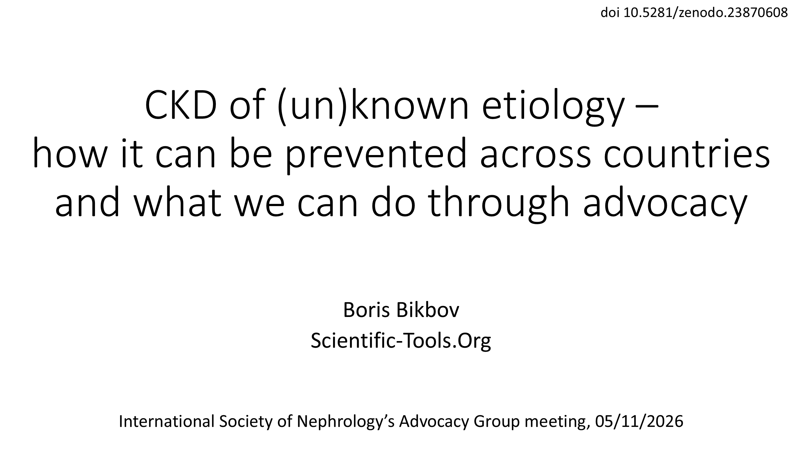
doi 10.5281/zenodo.23870608

Slide 2
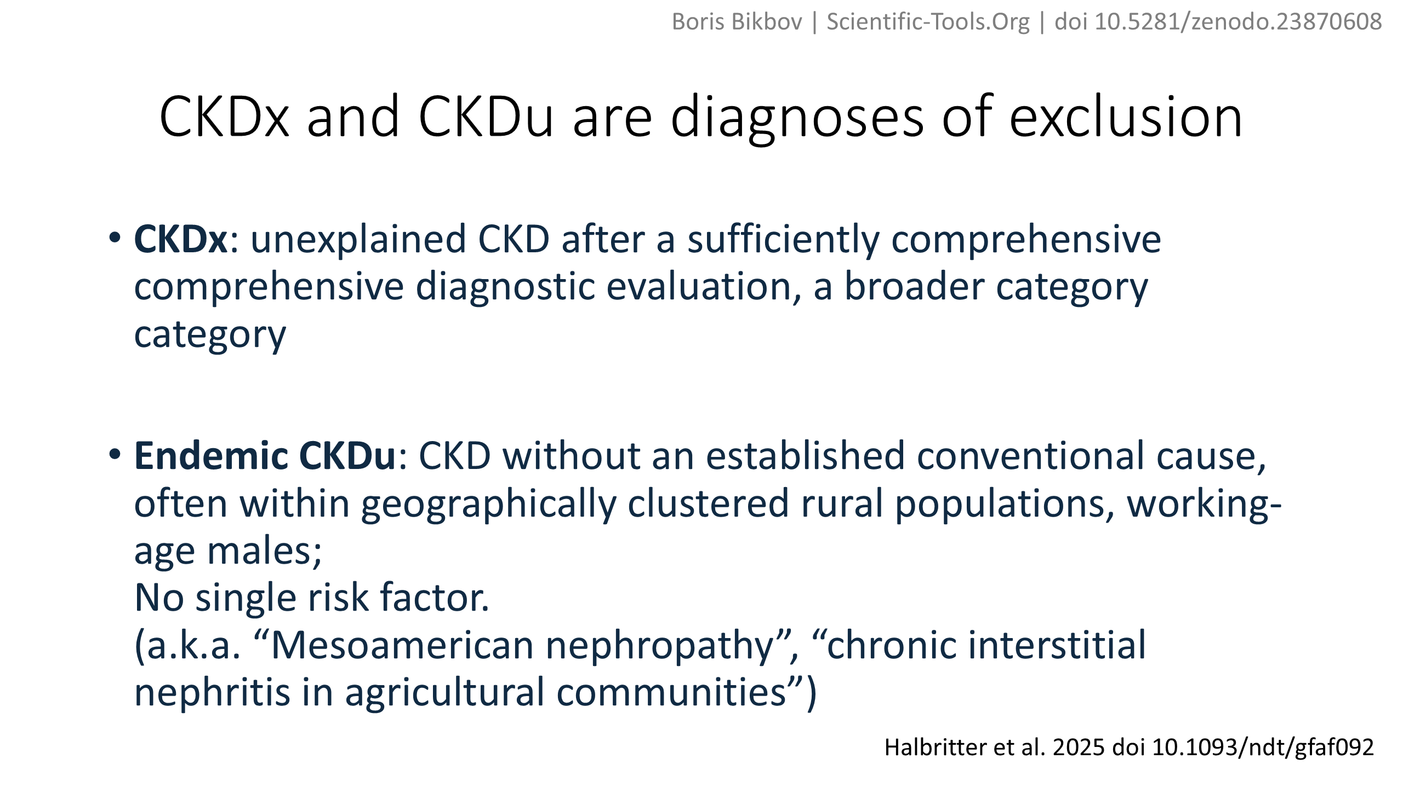
Boris Bikbov | Scientific-Tools.Org | doi 10.5281/zenodo.23870608
Halbritter et al. 2025 doi 10.1093/ndt/gfaf092

Slide 3
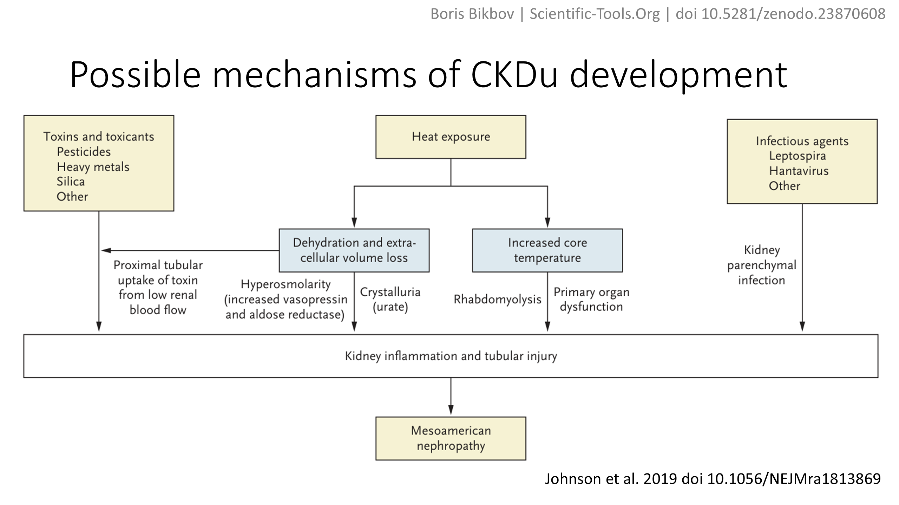
Boris Bikbov | Scientific-Tools.Org | doi 10.5281/zenodo.23870608
Johnson et al. 2019 doi 10.1056/NEJMra1813869

Slide 4
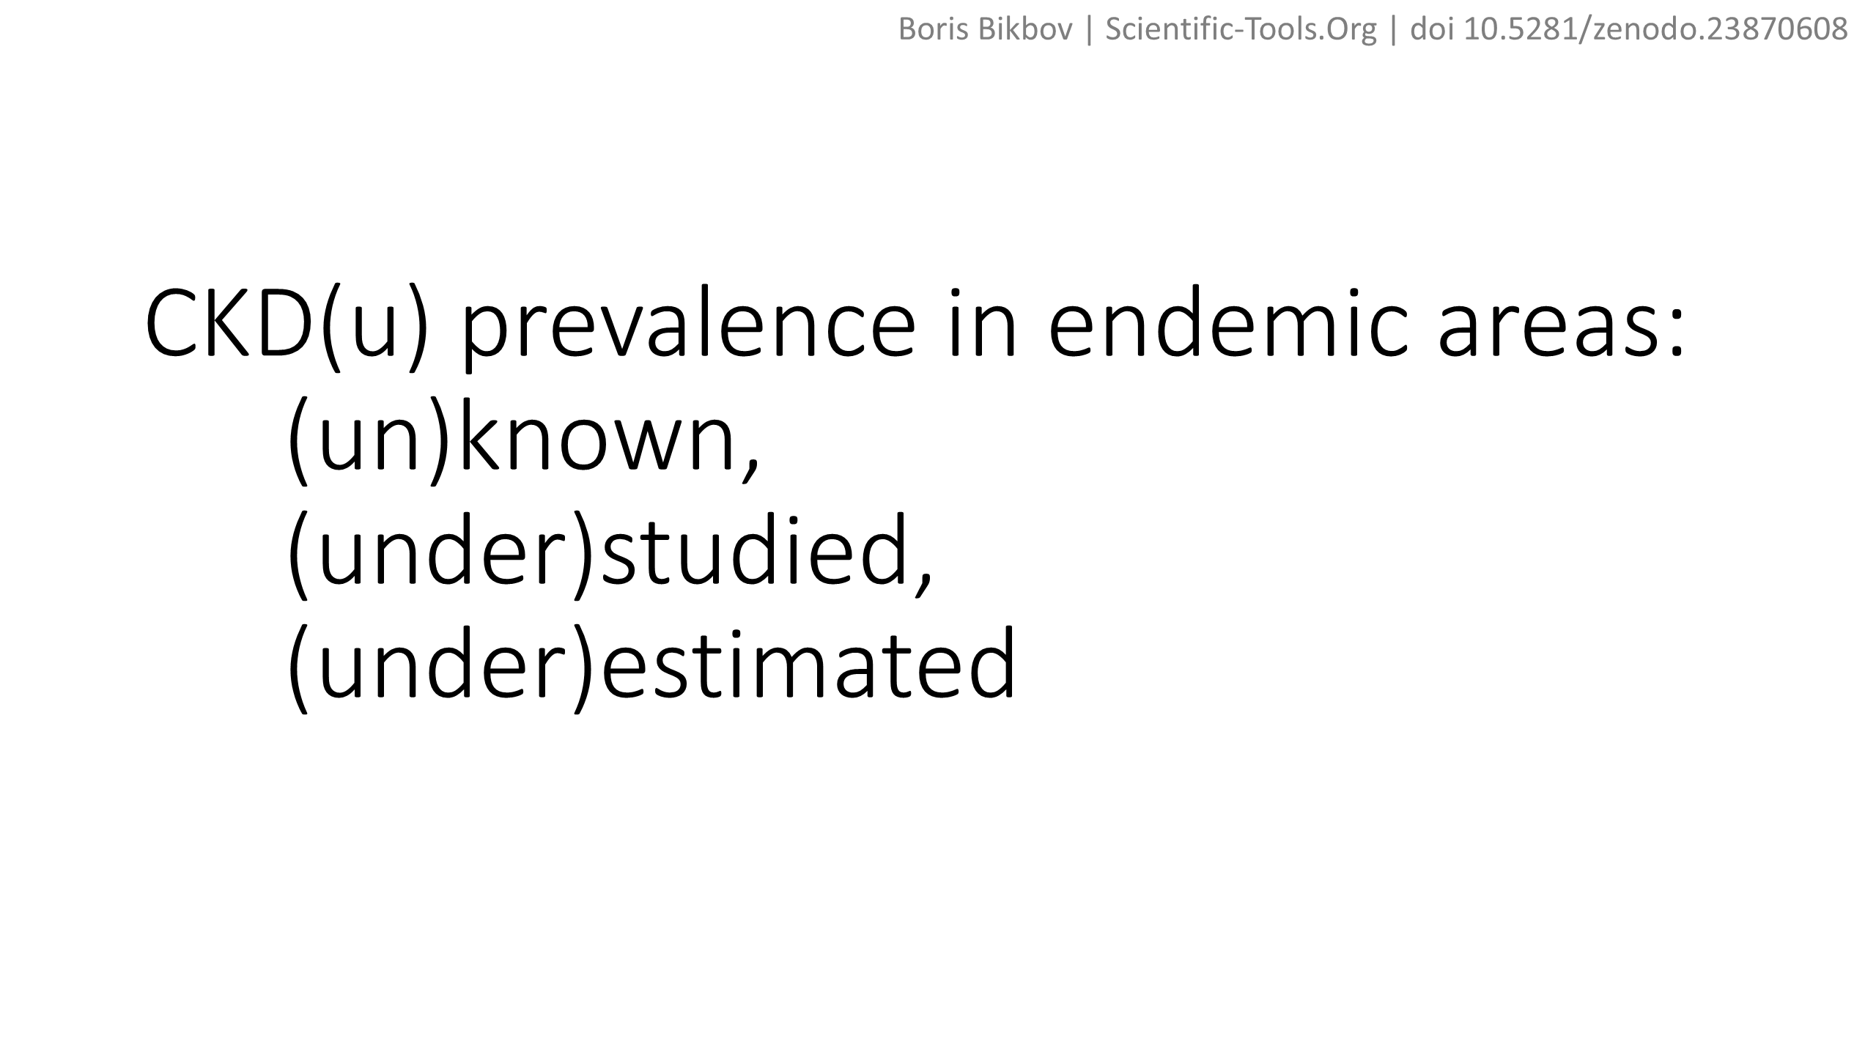
Boris Bikbov | Scientific-Tools.Org | doi 10.5281/zenodo.23870608

Slide 5
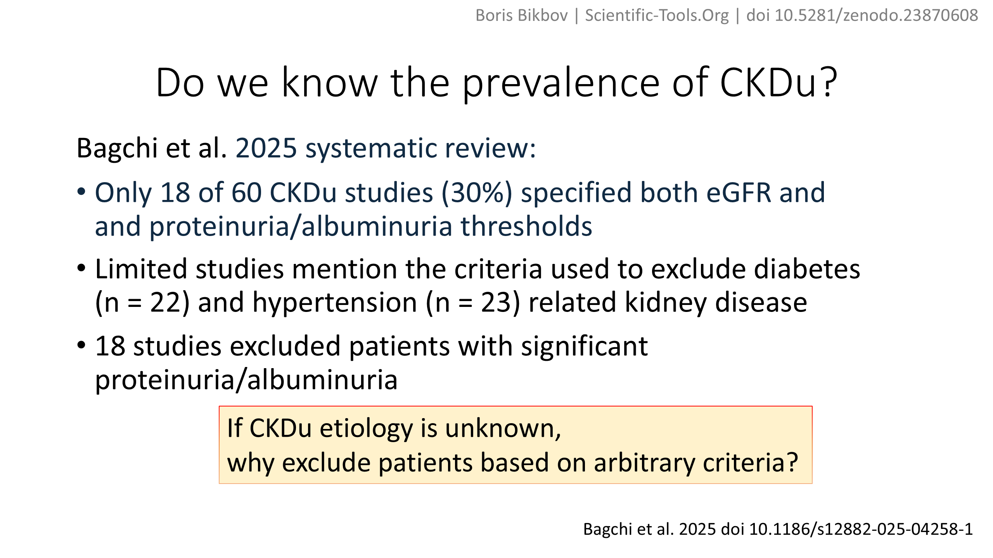
Boris Bikbov | Scientific-Tools.Org | doi 10.5281/zenodo.23870608
Bagchi et al. 2025 doi 10.1186/s12882-025-04258-1

Slide 6
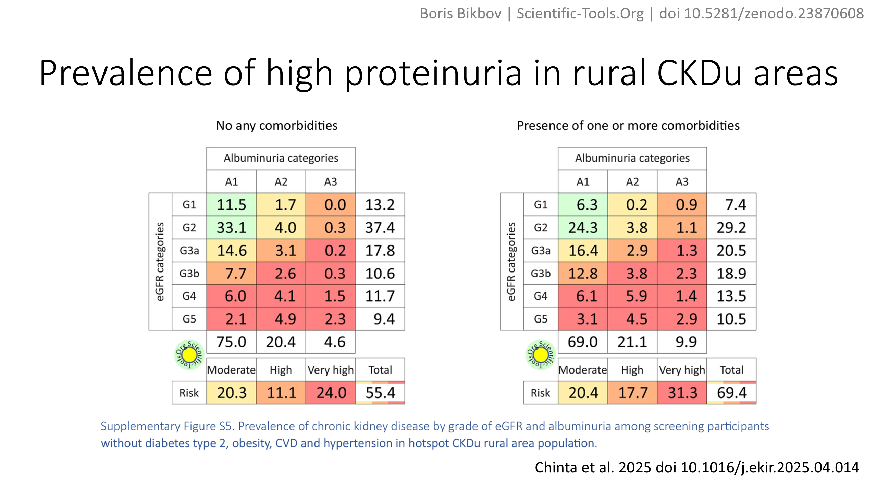
Boris Bikbov | Scientific-Tools.Org | doi 10.5281/zenodo.23870608
Chinta et al. 2025 doi 10.1016/j.ekir.2025.04.014

Slide 7
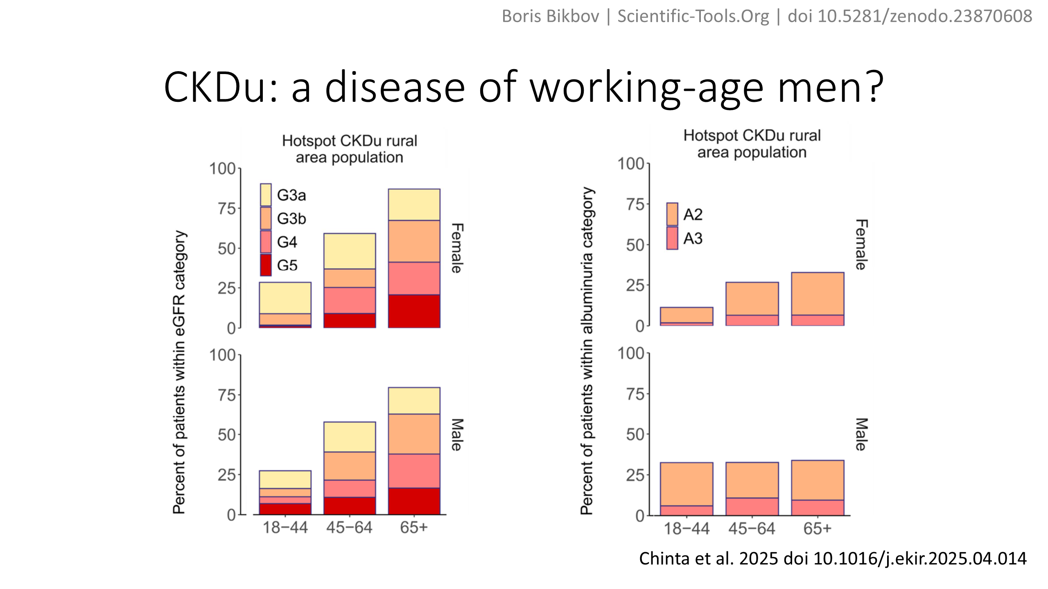
Boris Bikbov | Scientific-Tools.Org | doi 10.5281/zenodo.23870608
Chinta et al. 2025 doi 10.1016/j.ekir.2025.04.014

Slide 8
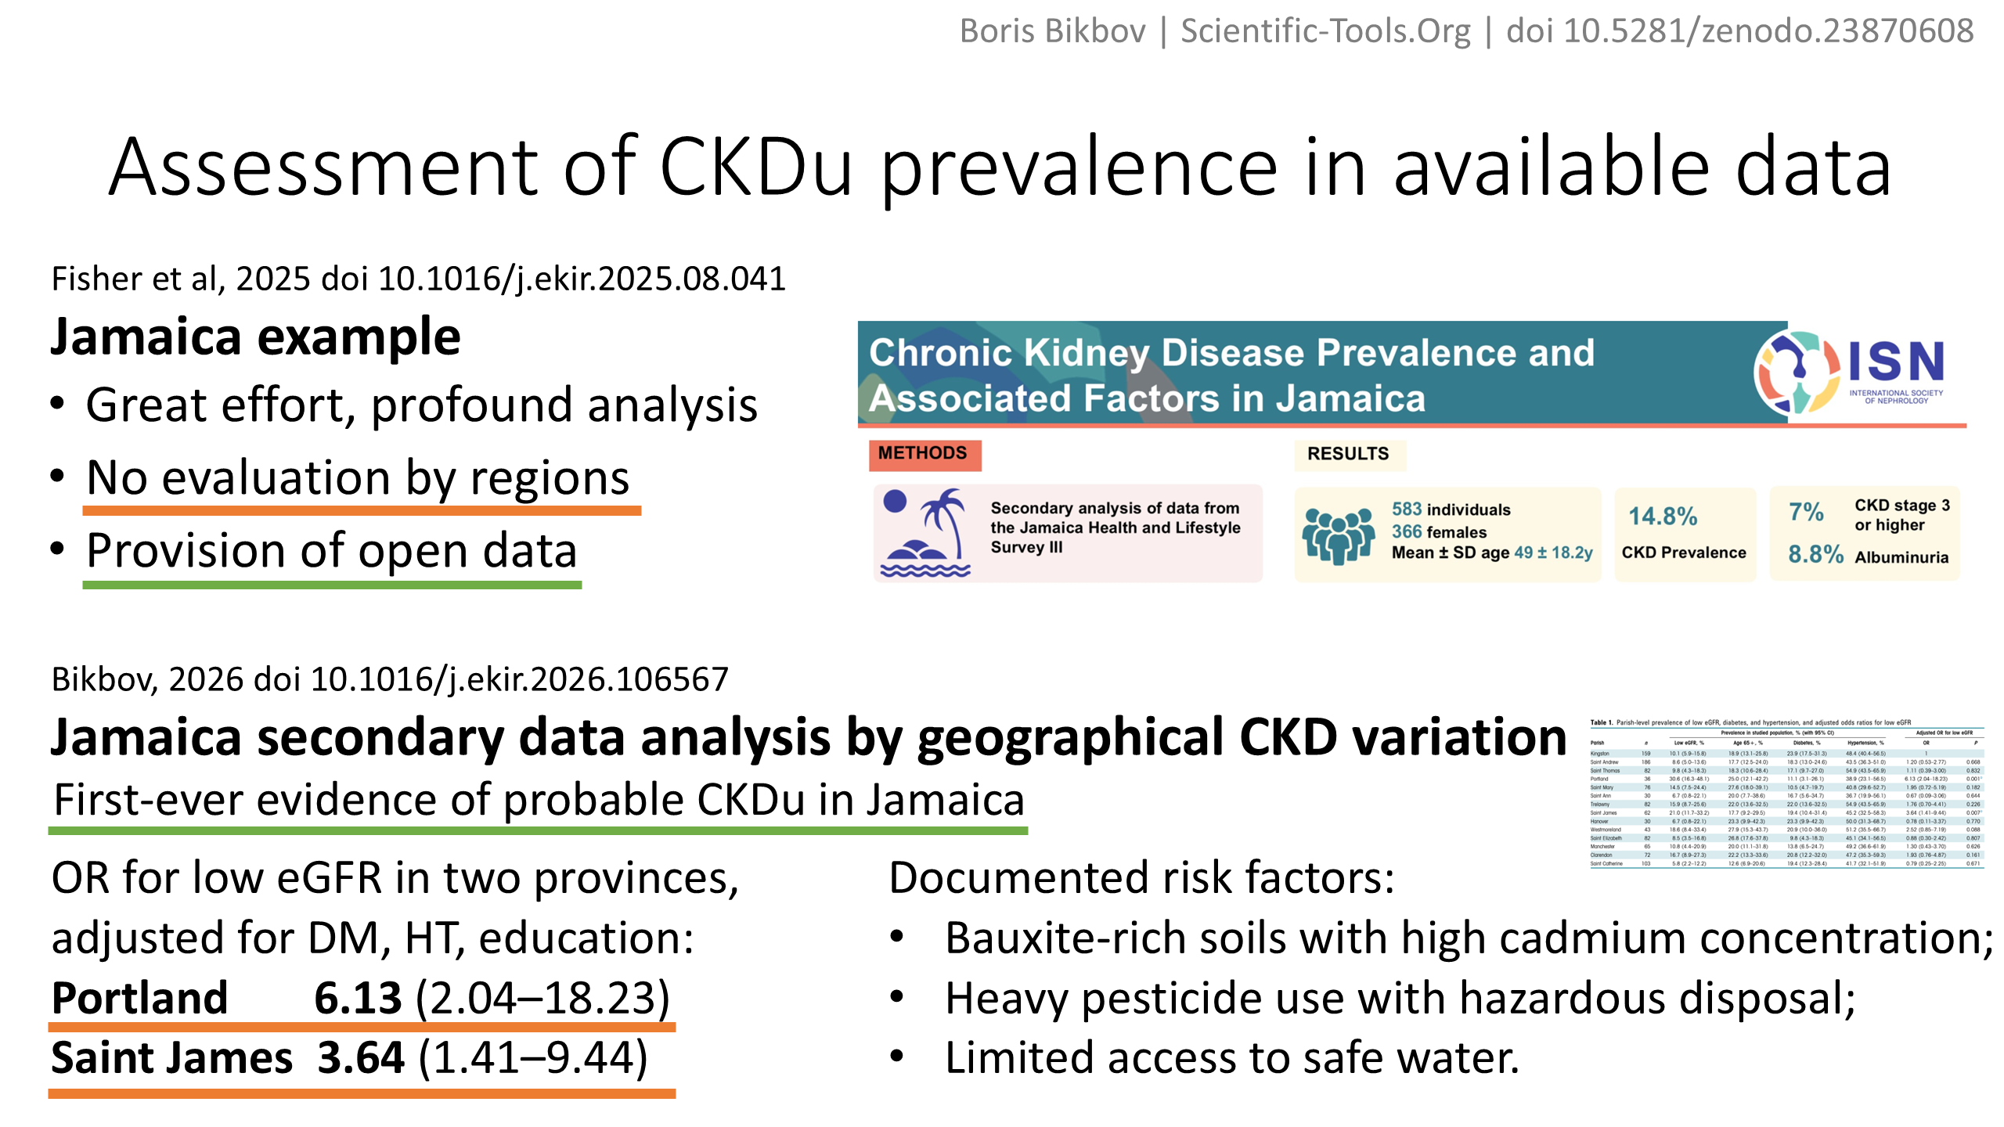
Boris Bikbov | Scientific-Tools.Org | doi 10.5281/zenodo.23870608
Fisher et al, 2025 doi 10.1016/j.ekir.2025.08.041
Bikbov, 2026 doi 10.1016/j.ekir.2026.106567

Slide 9
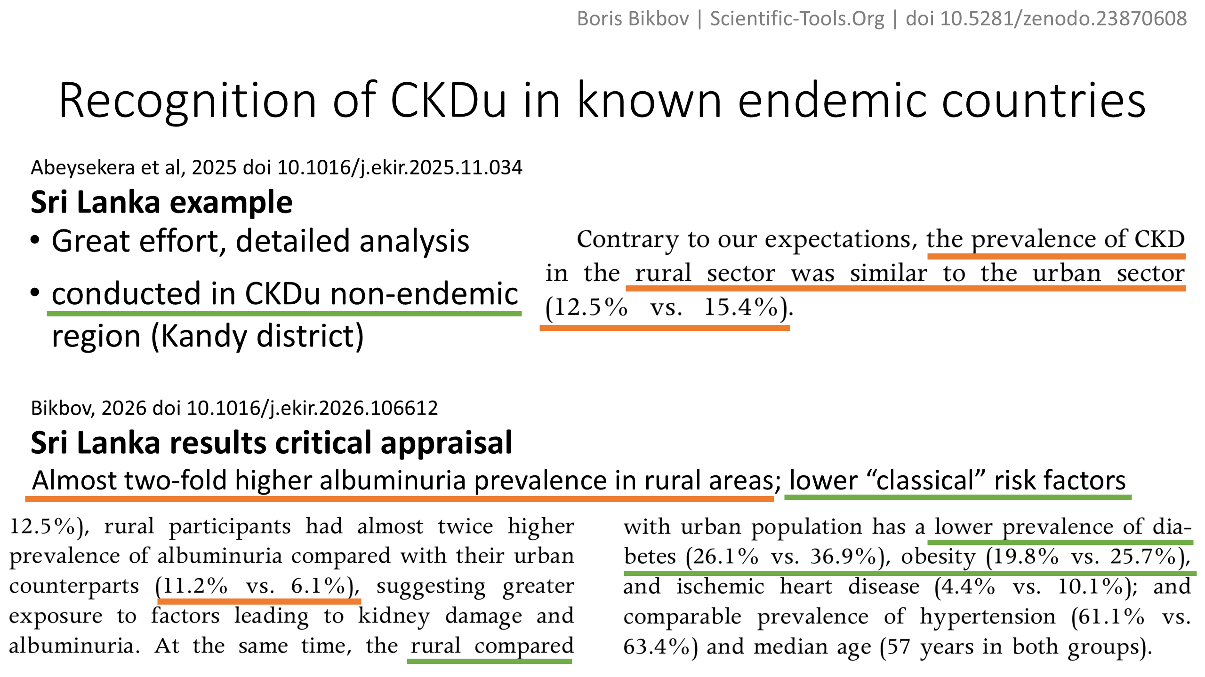
Boris Bikbov | Scientific-Tools.Org | doi 10.5281/zenodo.23870608
Abeysekera et al, 2025 doi 10.1016/j.ekir.2025.11.034
Bikbov, 2026 doi 10.1016/j.ekir.2026.106612

Slide 10
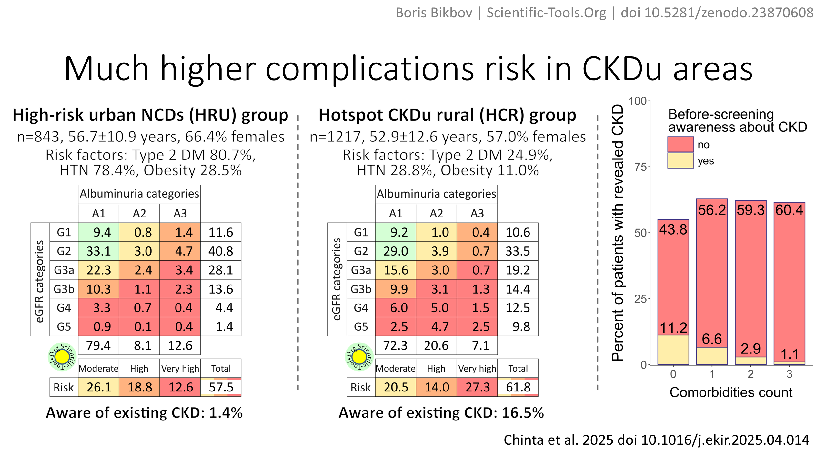
Boris Bikbov | Scientific-Tools.Org | doi 10.5281/zenodo.23870608
Chinta et al. 2025 doi 10.1016/j.ekir.2025.04.014

Slide 11
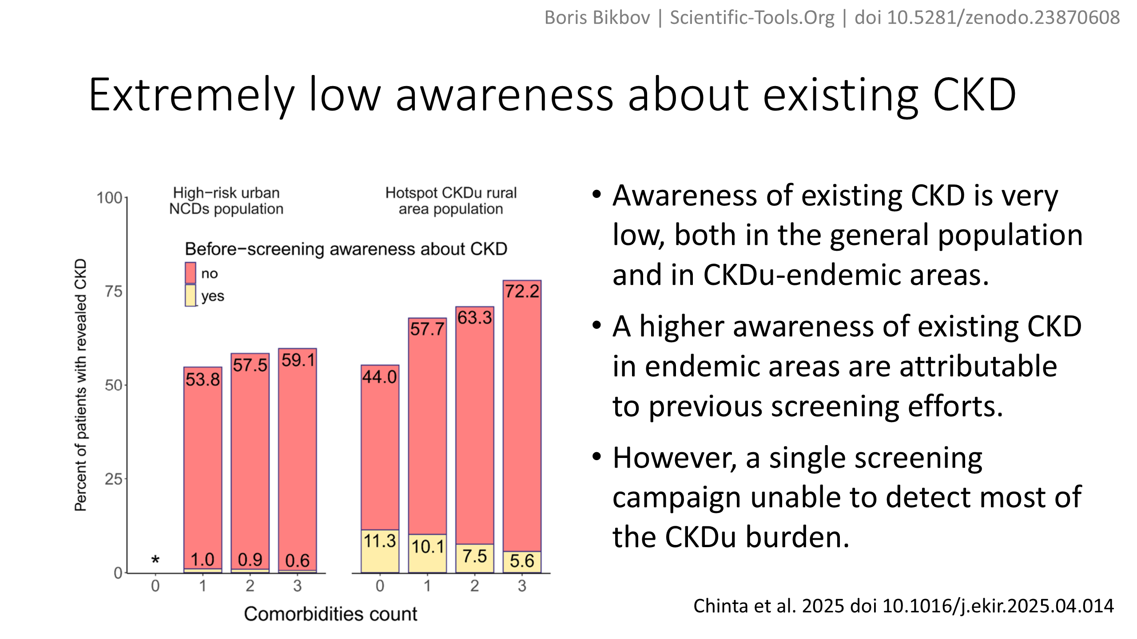
Boris Bikbov | Scientific-Tools.Org | doi 10.5281/zenodo.23870608
Chinta et al. 2025 doi 10.1016/j.ekir.2025.04.014

Slide 12
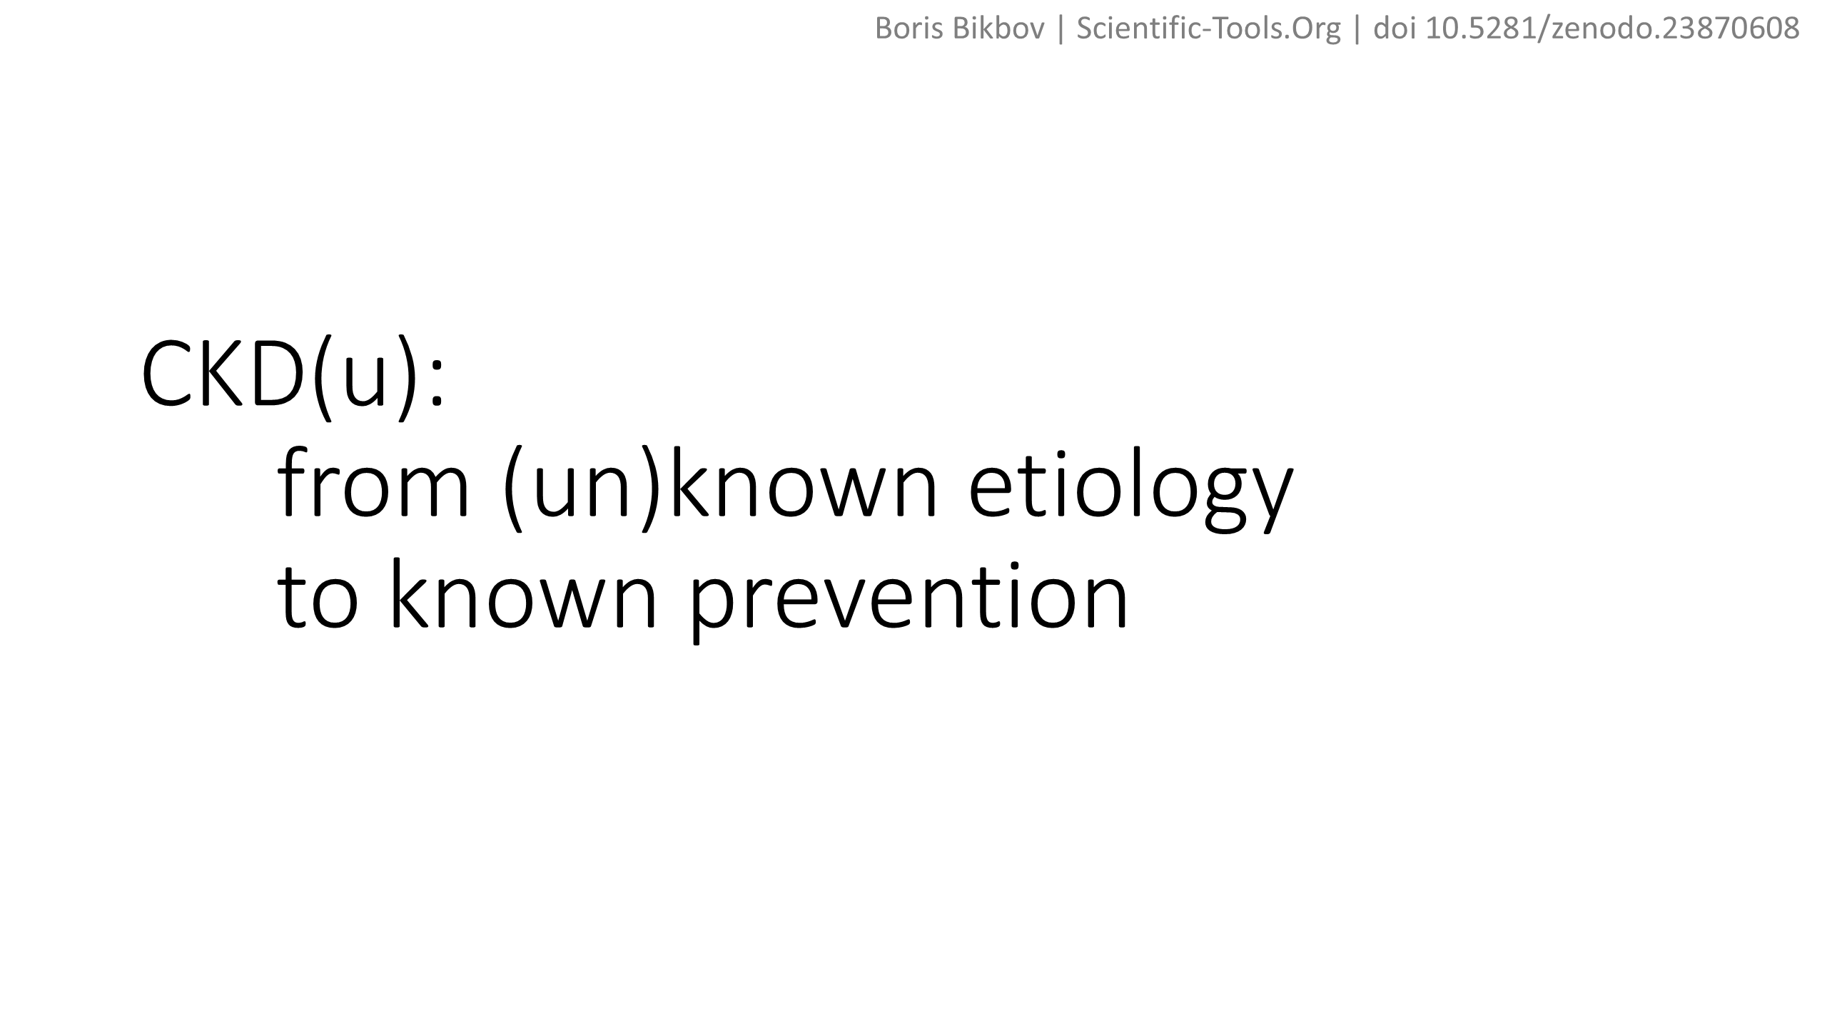
Boris Bikbov | Scientific-Tools.Org | doi 10.5281/zenodo.23870608

Slide 13
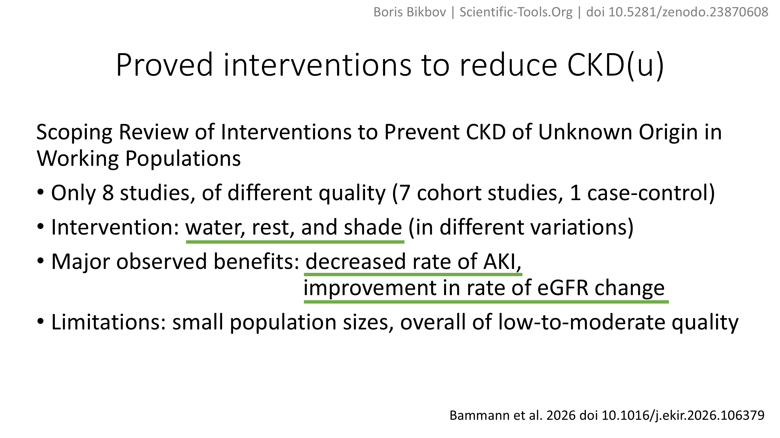
Boris Bikbov | Scientific-Tools.Org | doi 10.5281/zenodo.23870608
Bammann et al. 2026 doi 10.1016/j.ekir.2026.106379

Slide 14
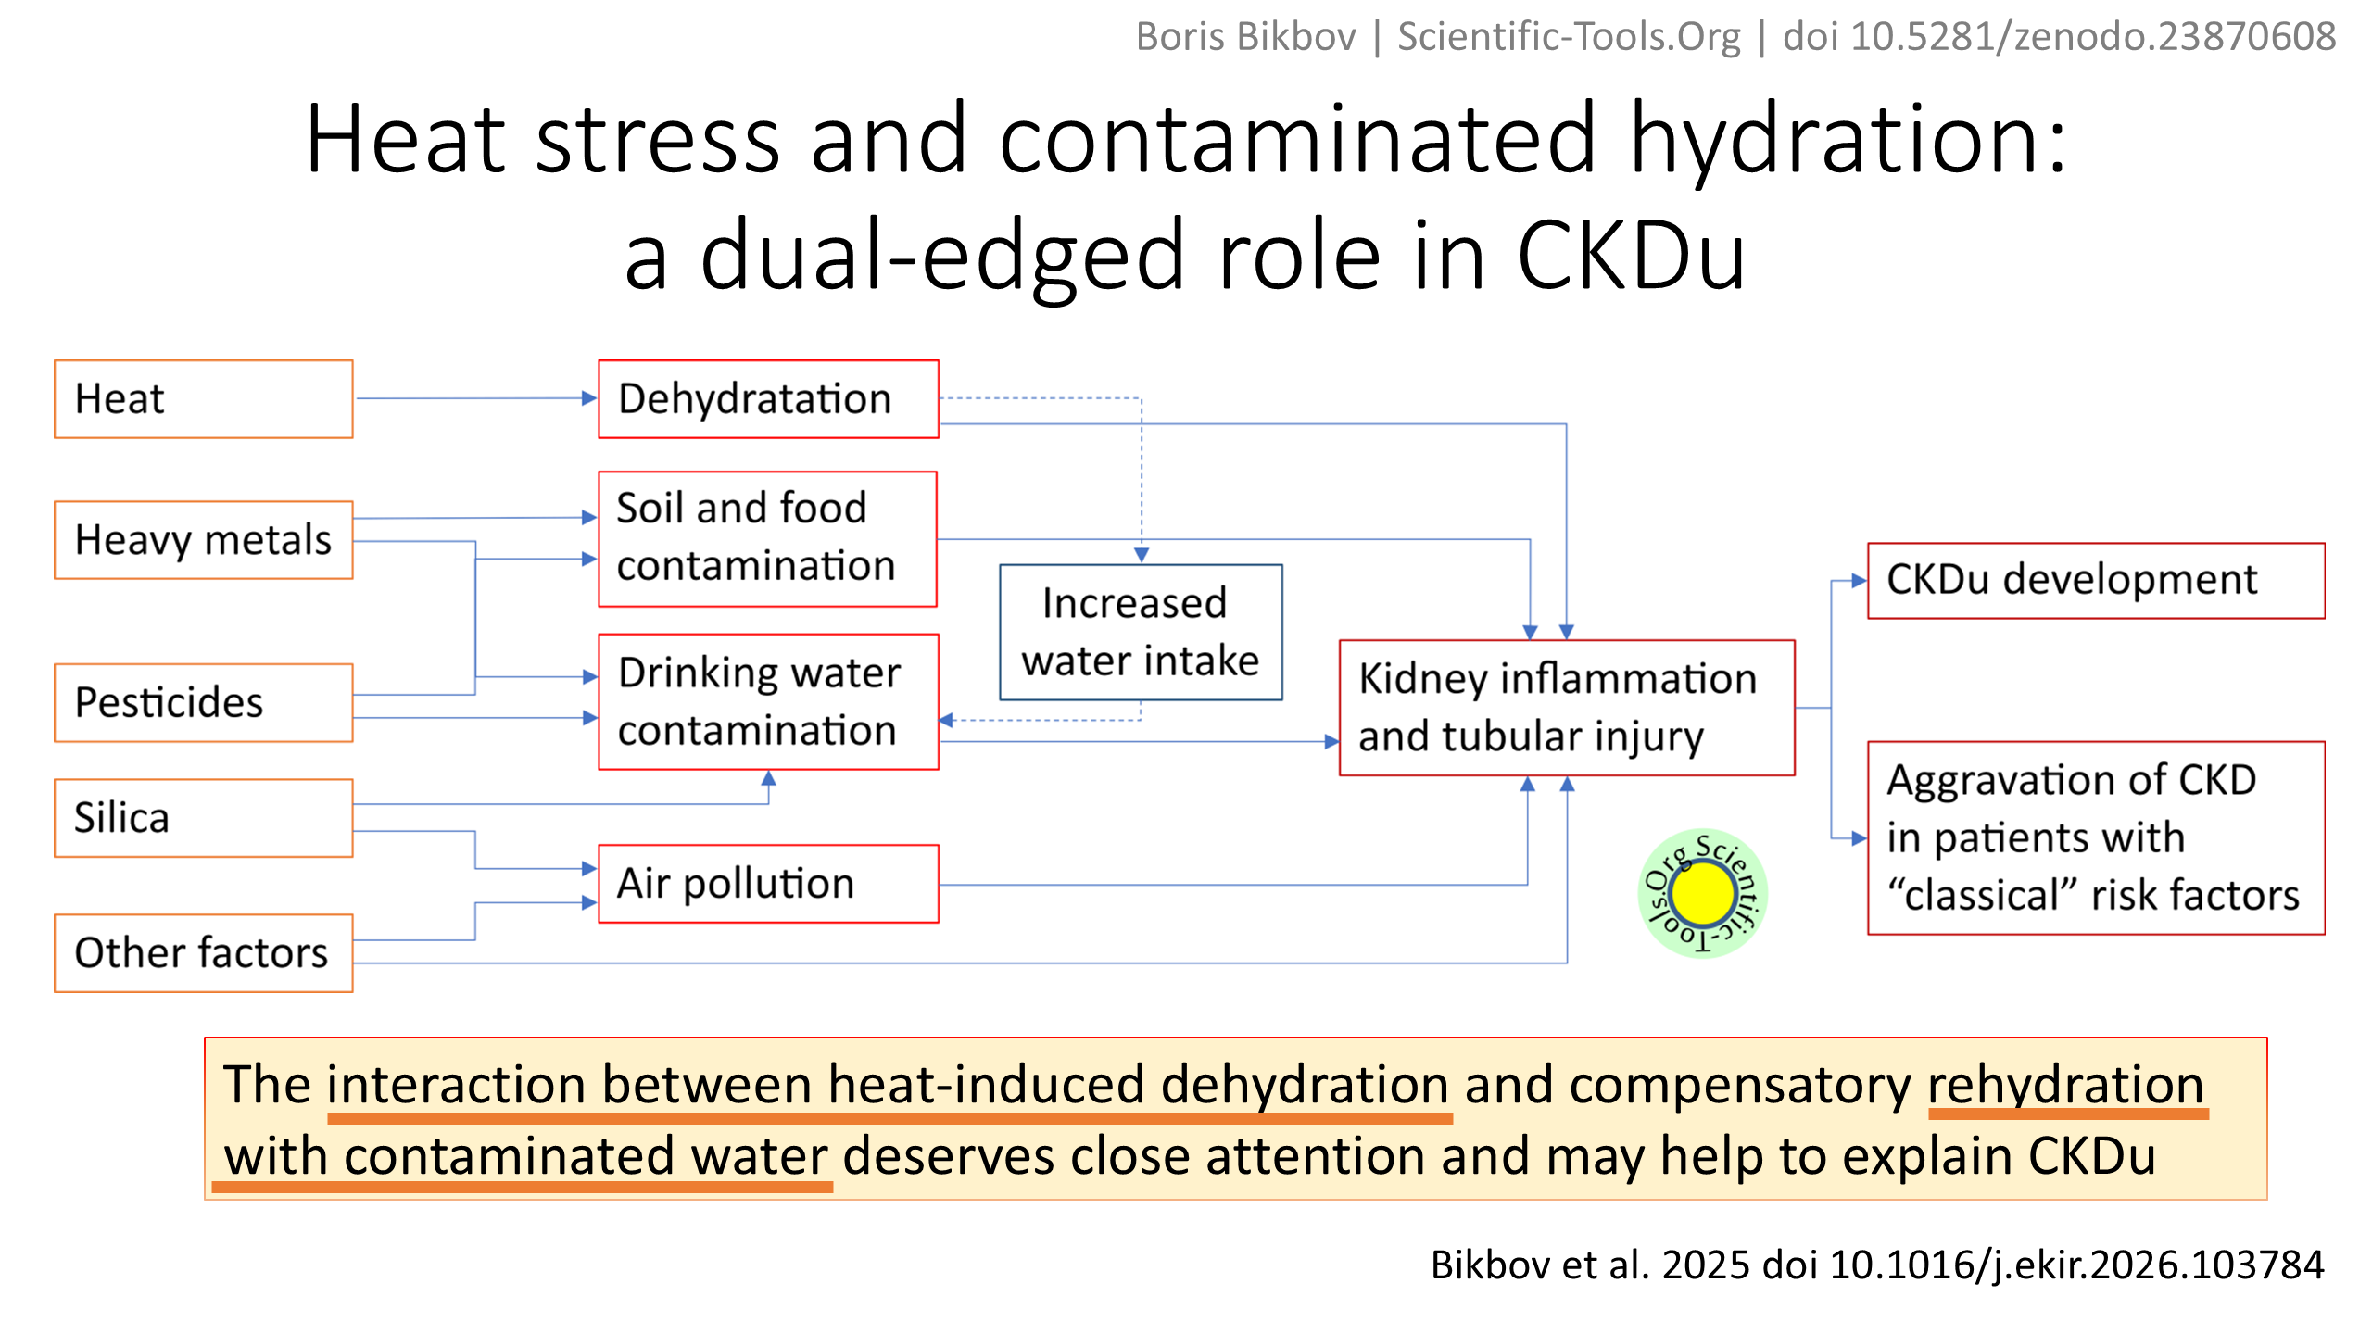
Boris Bikbov | Scientific-Tools.Org | doi 10.5281/zenodo.23870608
Bikbov et al. 2025 doi 10.1016/j.ekir.2026.103784

Slide 15
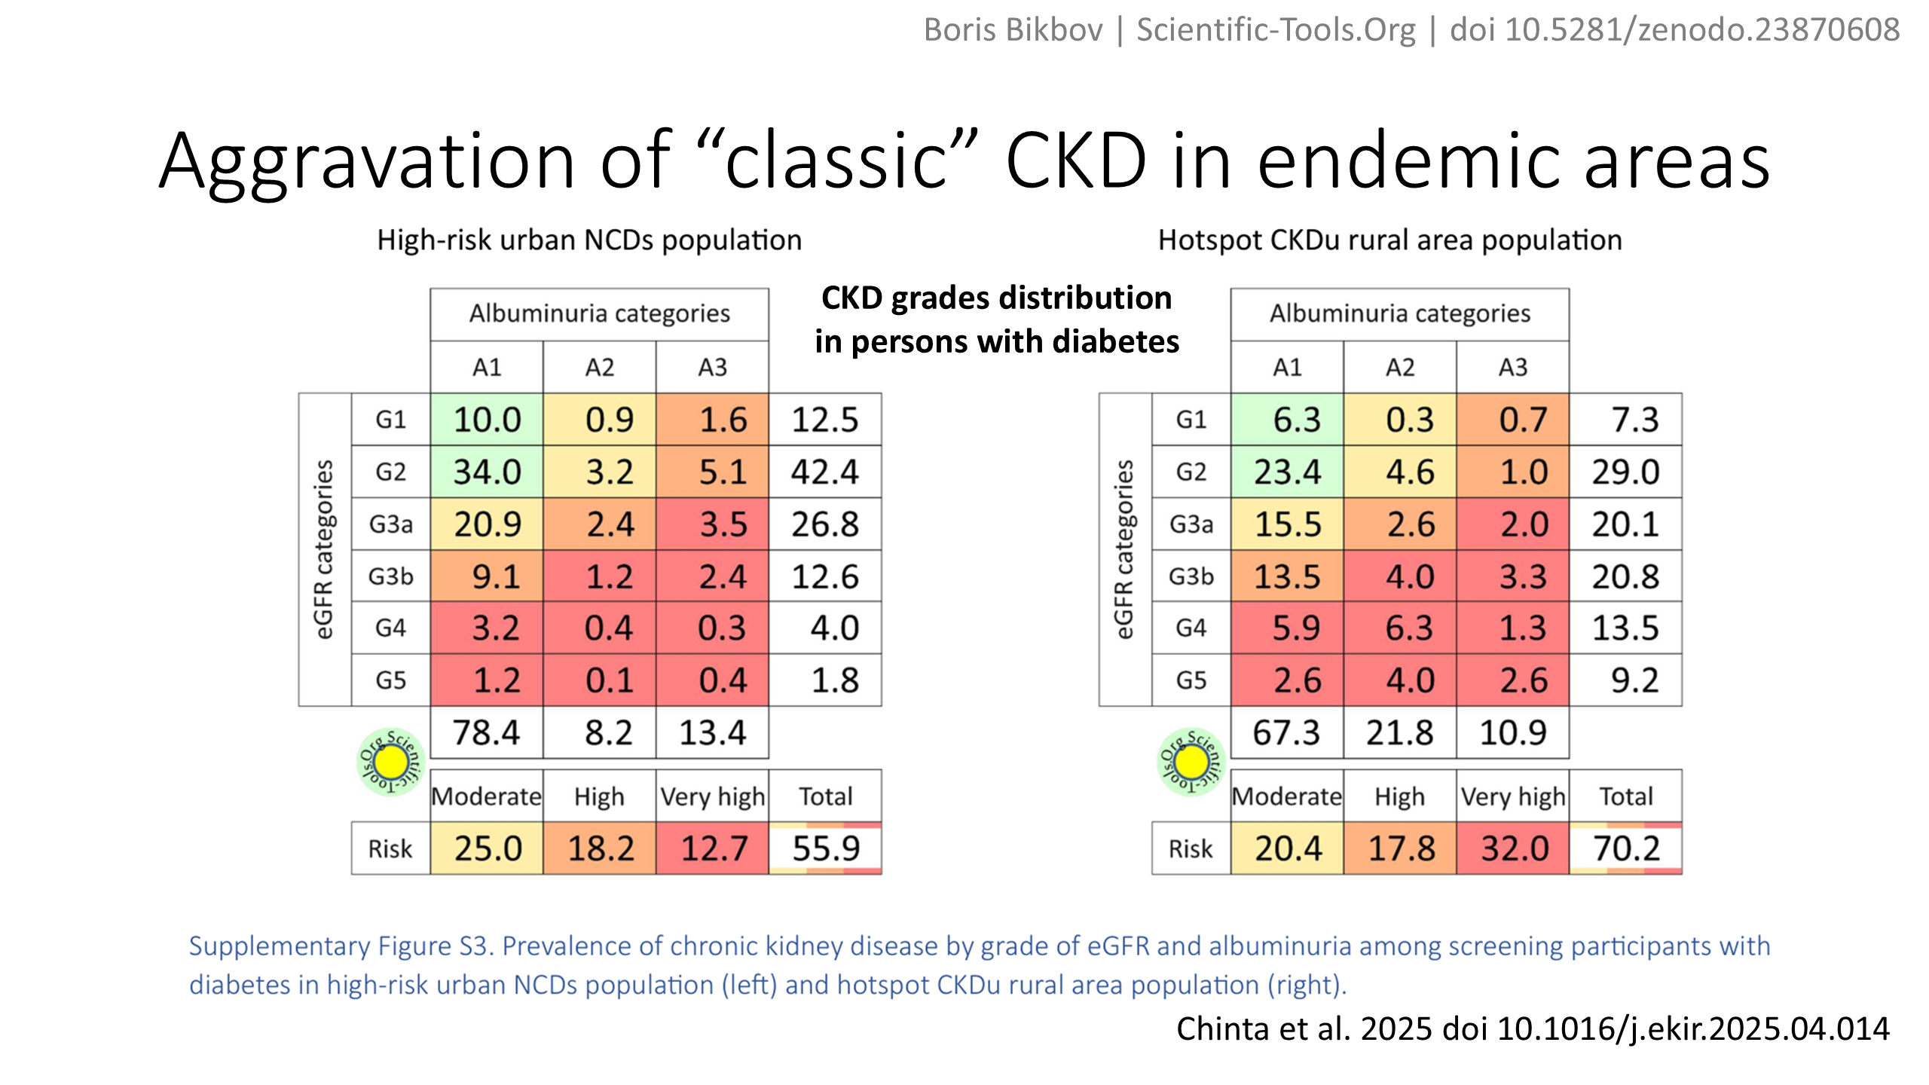
Boris Bikbov | Scientific-Tools.Org | doi 10.5281/zenodo.23870608
Chinta et al. 2025 doi 10.1016/j.ekir.2025.04.014

Slide 16
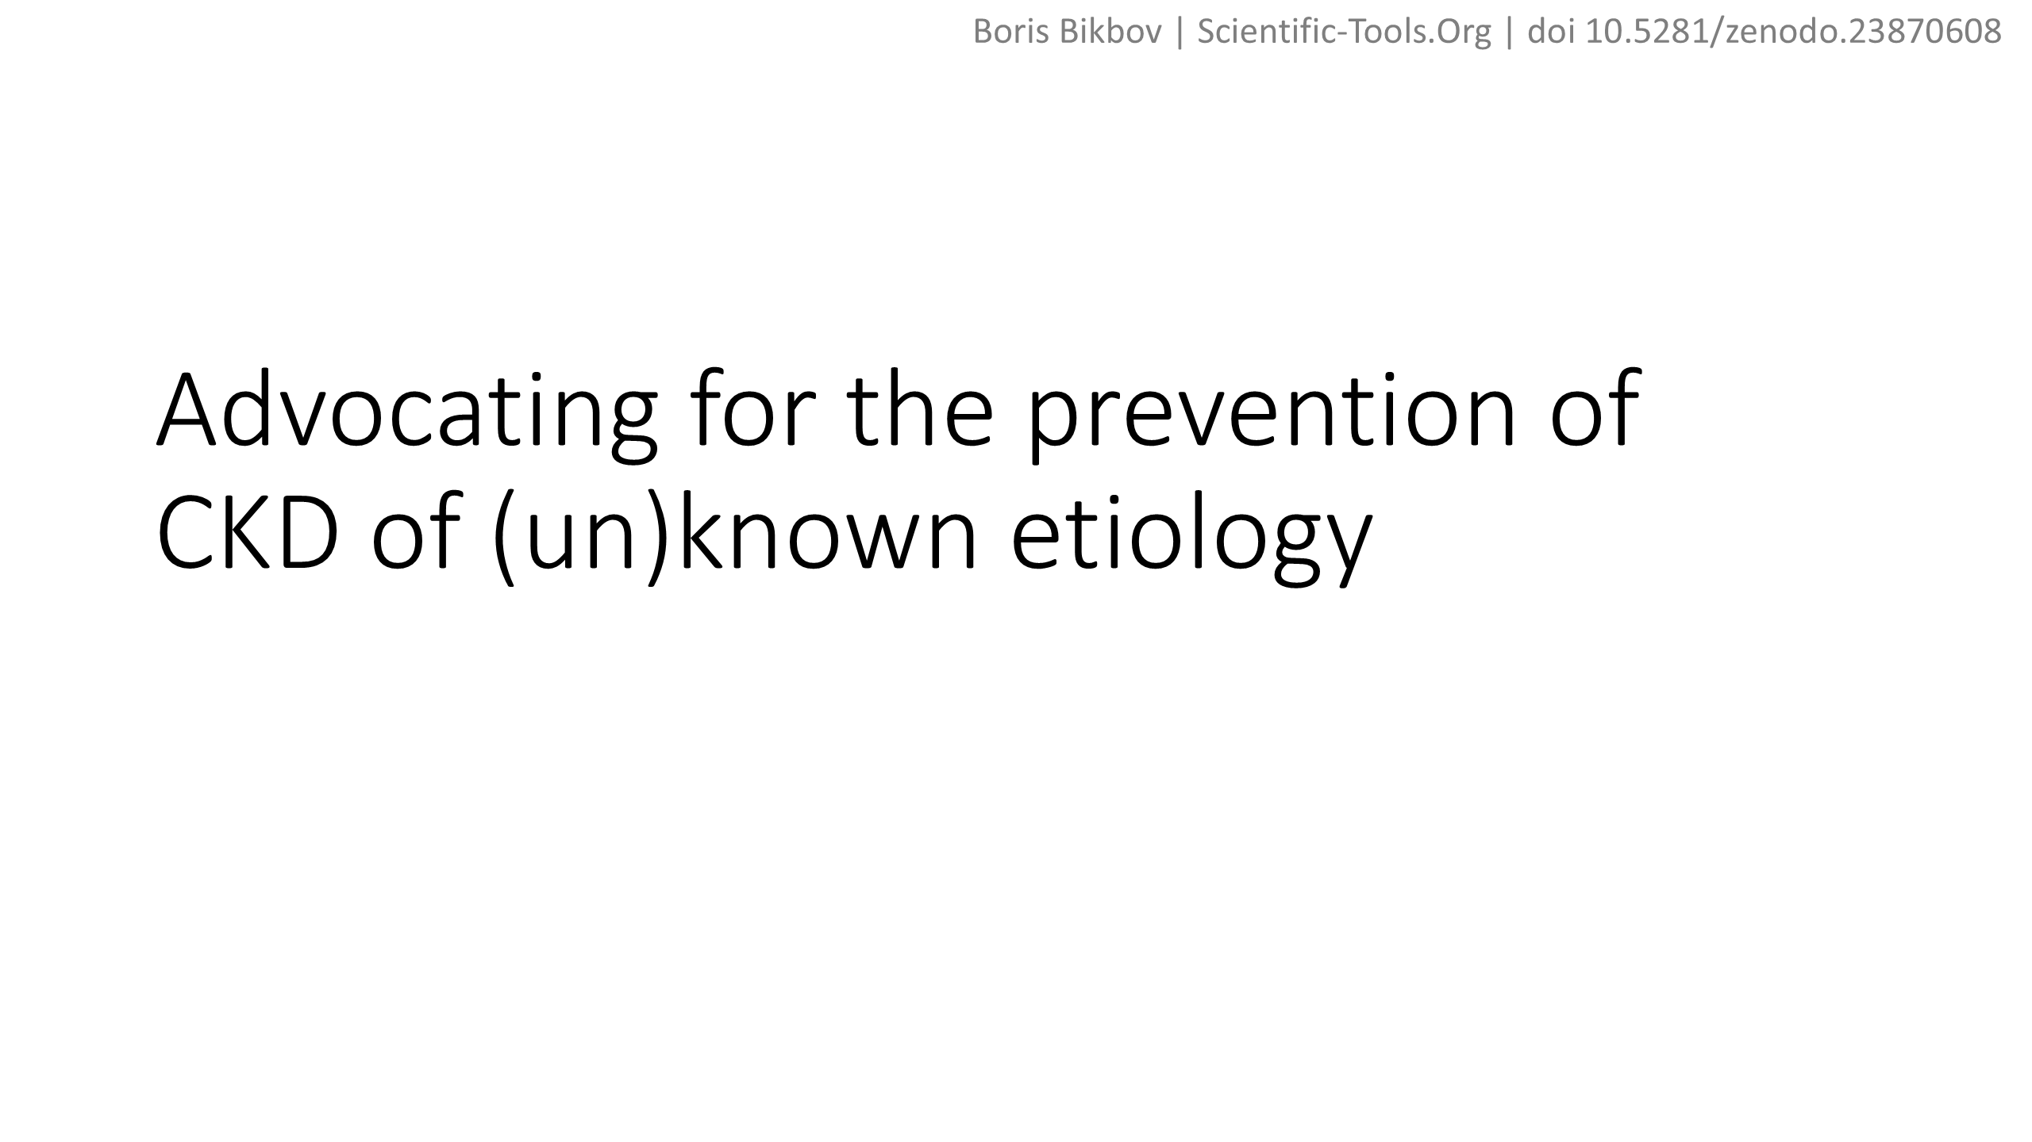
Boris Bikbov | Scientific-Tools.Org | doi 10.5281/zenodo.23870608

Slide 17
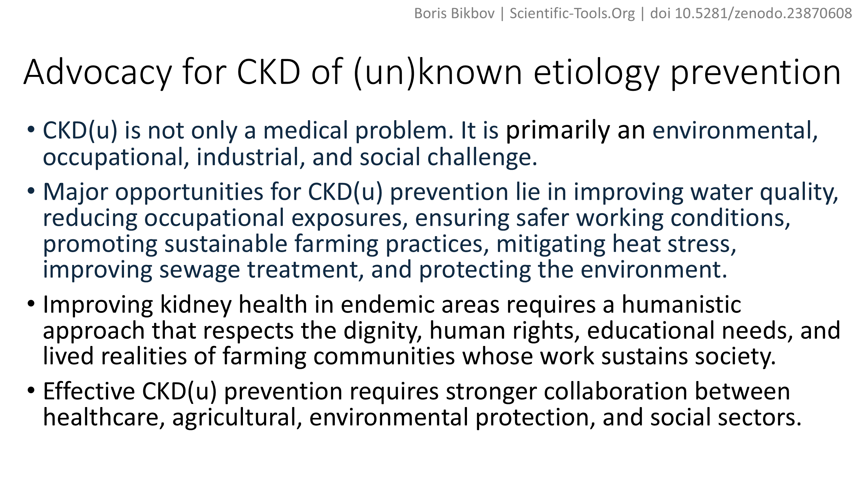
Boris Bikbov | Scientific-Tools.Org | doi 10.5281/zenodo.23870608

Slide 18
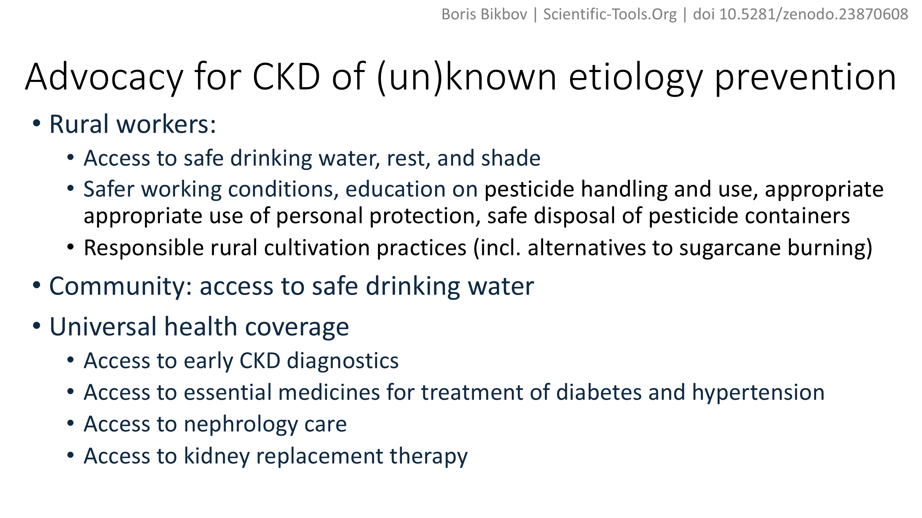
Boris Bikbov | Scientific-Tools.Org | doi 10.5281/zenodo.23870608

